Slide 1


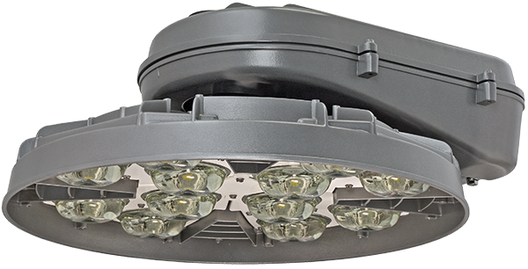

HMAO™ LED IV
HMLED4 Roadway & Area Lighting

Slide 2
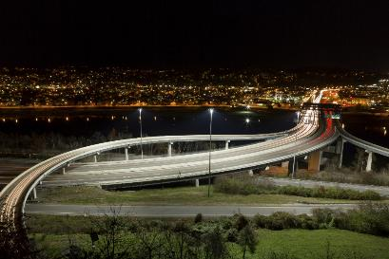
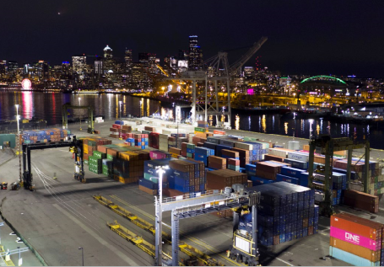
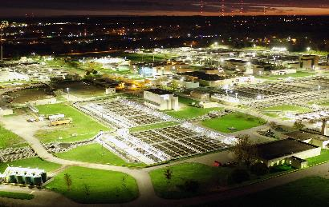
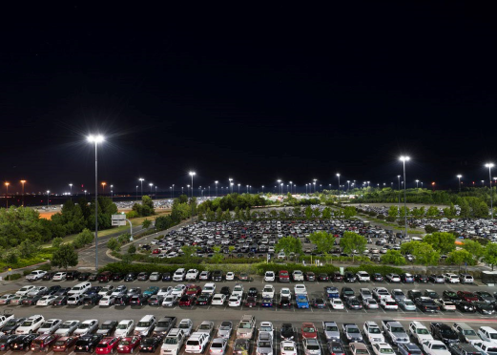

HMLED4: Applications
Port Container Facilities
Highways and Interchanges
Rail Yards
Correctional Facilities
Large Area Industrial
Wastewater Treatment Plants
Airports
Toll Plazas
Truck Stops
Security Lighting

Slide 3
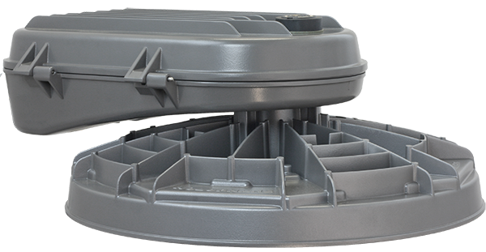

HMLED4: Core Benefits
True 1000+ watt HPS high mast replacement
High lumen packages may allow for luminaire reduction
Highest efficacy high-mast luminaire on market
Precision glass optics for both area and roadway applications
provide high application efficacy, uniformity, and glare control
Robust mechanical design “best-in-class” for high mast market
  3G Rated
  IP66 Optics
  4-bolt Mounting
  5,000-hr salt fog rated finish
Long system life with driver life exceeding 100,000 hours and LED life of L82 @ 100,000 hours
Multiple control options for enhanced operational efficiency and savings
Field-adjustable lumen output available
Reliability of industry's most experienced high-mast manufacturer

Slide 4
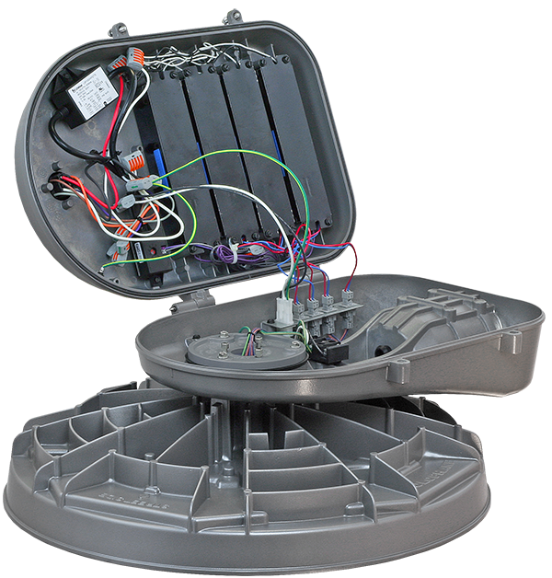
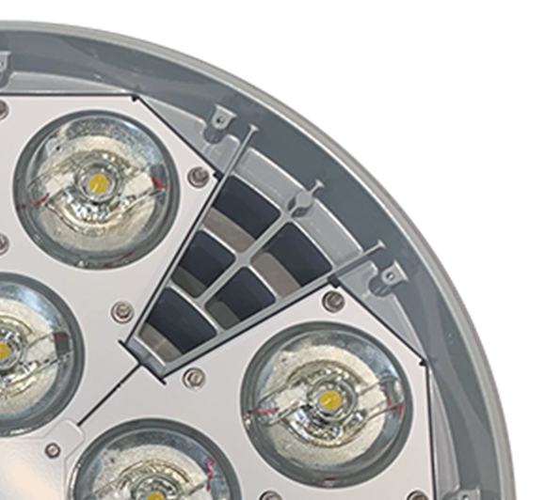
HMLED4: Best-In-Class Construction
20kV/10kA extreme surge
Removable driver door
4 bolt luminaire arm mount
Fully sealed and gasketed
Prismatic glass optics
3-stage terminal block
Die-Cast
Low Copper Aluminum Housing
Rotatable optical assembly

Slide 5
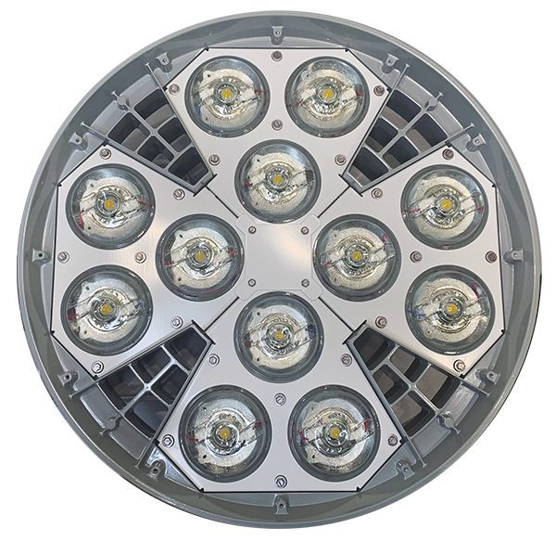
HMLED4: Optical Excellence
New Prismatic Glass Optics
Superior durability
No yellowing, hazing or cracking
Precision optical control
Enhanced glare control

Slide 6
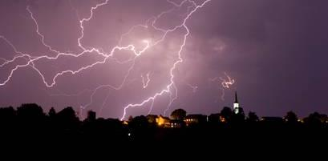
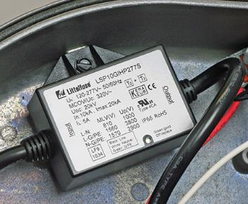
HMLED4 Surge Protection
20kV/10kA
Industry’s best surge protection
Fail off design protects luminaire

Slide 7
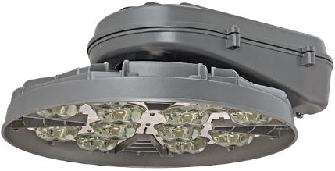
NEW: More Lumens
True 1000W HPS replacement
More lumens
  40% higher lumen output than HMLED3!
  Over 117,000 lumens
Higher LPW
  ~7% higher LPW for all packages
  Industry’s most efficient high mast
Excellent lumen maintenance
  LED maintenance > 87% at 60,000 hrs.
Easy conversion from HMLED3
  Equal lumen packages
  Lower wattage
High ambient listing
  Support for 50°C ambient up to P5 with 100,000+ lumen package (ADOT and NDOT)
CURRENT STATE HMLED3 (4000K, AW optic)
PKG | Lumens | Watts | LPW
PK1 | 31,700 | 209 | 152
PK2 | 44,908 | 319 | 141
PK3 | 64,742 | 475 | 136
PK4 | 83,170 | 627 | 133
FUTURE STATE HMLED4 (4000K, AW optic)
PKG | Lumens | Watts | LPW
P1 | 31,222 | 199 | 157
P2 | 44,466 | 295 | 151
P3 | 64,390 | 429 | 150
P4 | 82,761 | 582 | 142
P5 | 103,569 | 703 | 147
P6 | 108,436 | 753 | 144
P7 | 117,139 | 838 | 140
NEW
NEW
NEW

Slide 8
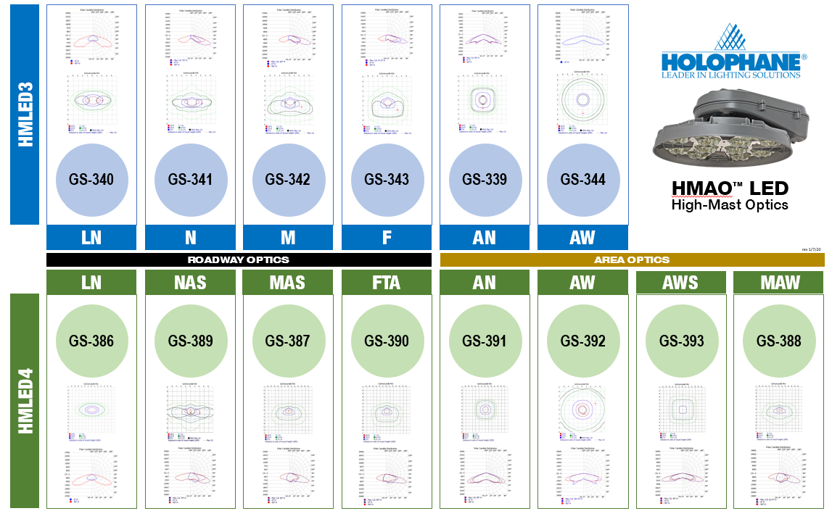
NEW
NEW

Slide 9
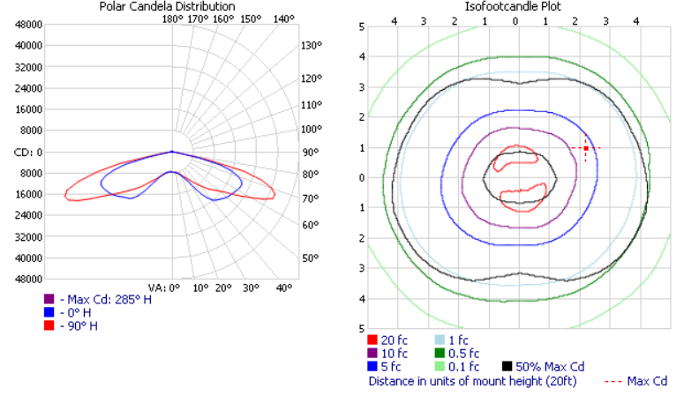
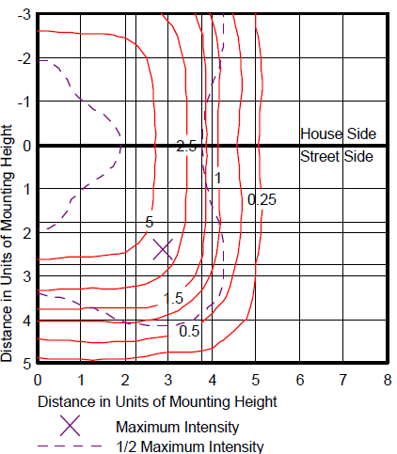
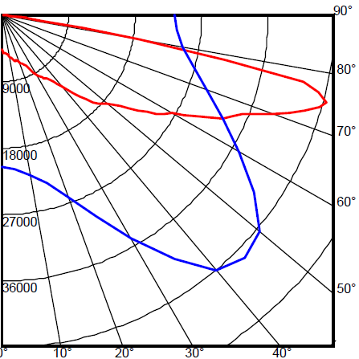
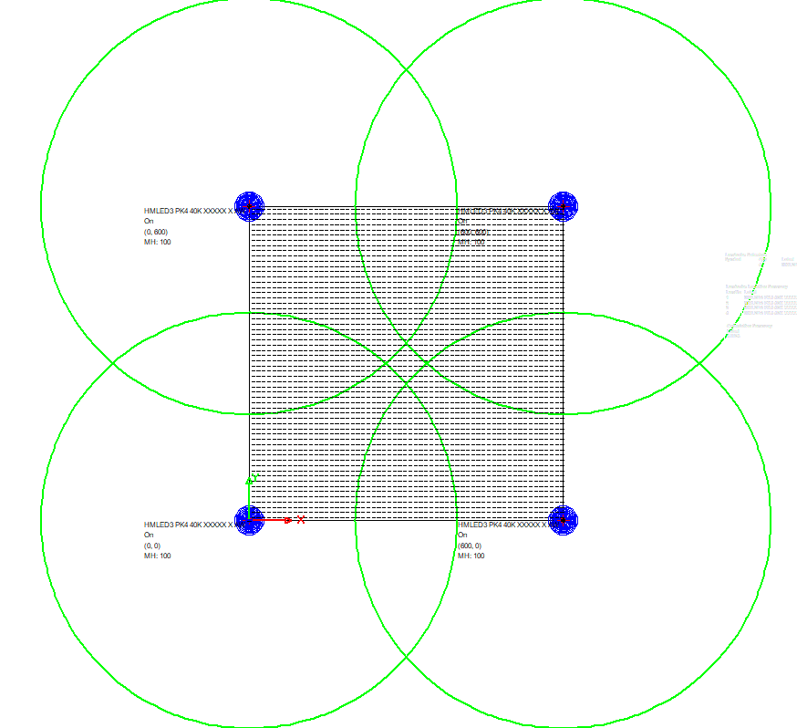
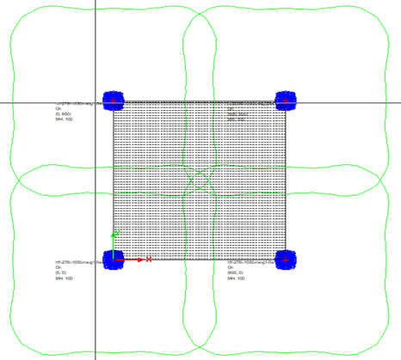
NEW: Area Wide Square (AWS) Optic
Square pattern pushes more light towards each corner
The “square” pattern of the AWS will fill in the “donut hole” on 2x2 area
Reference AW
New AWS
Reference AW
New AWS

Slide 10

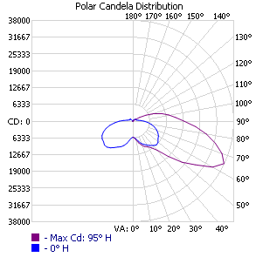
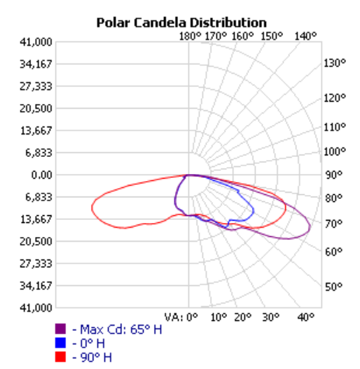
NEW: Medium Asymmetric Wide (MAW) Optic
Provides the LED solution for HMST legacy
Reference HMST 1000W HPS A1
HMLED4 MAW Optics
  Match high beam angle, which is characteristic of legacy HMST fixtures
  Maintain zero uplight rating
  Achieve wide pole spacing
  Meet veiling luminance requirements

Slide 11
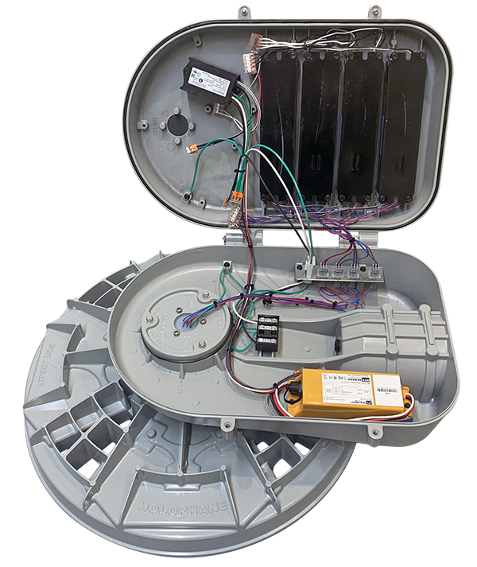
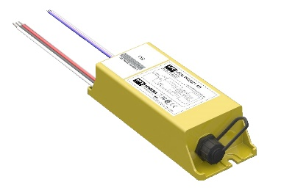
NEW: Added Controls Options
PR7 NEMA 7 Pin Photocontrol Receptacle
  Integrates any twist-lock control device
AO Adjustable Output option
  Simple manual adjustment of light output
DALI drivers available for MVOLT (via RFD)
ICMNYX Nyx Hemera LPC480 controller:
  Ideal for ports, prisons, and other facilities where robust communication is valued
  Secure, robust powerline communication
  Sophisticated control capabilities and condition monitoring
  Available up to P4 lumen package
NEW
NEW

Slide 12
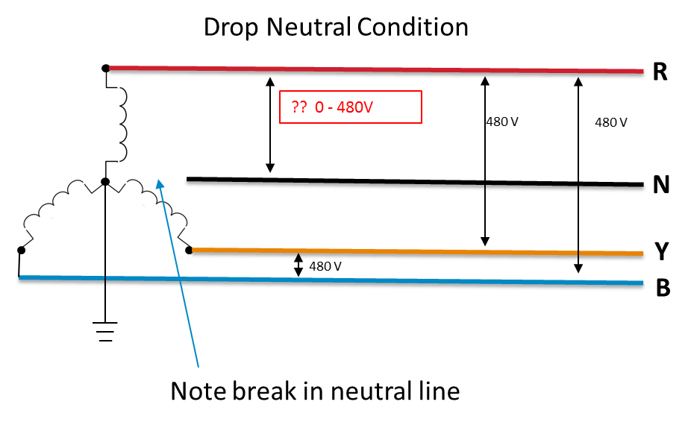
NEW: Available with XVOLT “TANK” Driver Option
NEW
XVOLT driver option designed for 277-480V input voltage range
Ideal for 277V circuits derived from 480V-Wye transmission
Ideal for aging infrastructure with power quality problems
Protection against dropped neutral, which results in 480V on circuit
  Note: dropped neutrals must be repaired by an electrician and could result in erratic behavior of the luminaire
Greater immunity to 6 types of common power quality issues:
  Voltage Notching, Swells, and Temporary Over-Voltages
  Capacitor Switching Voltage Transients
  Impulsive Transient Voltages
Peace of mind—greatest possible protection
SPD cannot protect against dirty power
Premium cost for premium drivers

Slide 13
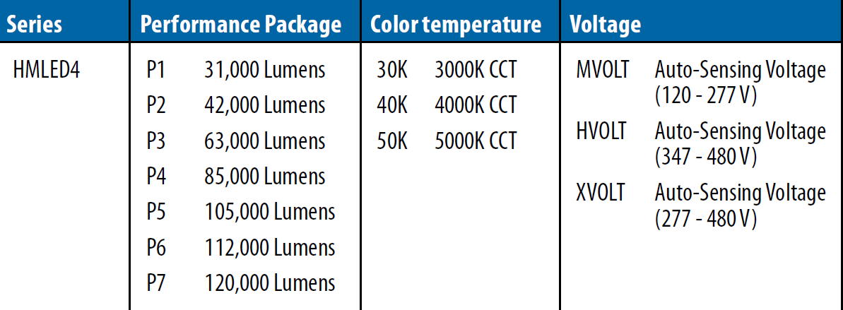
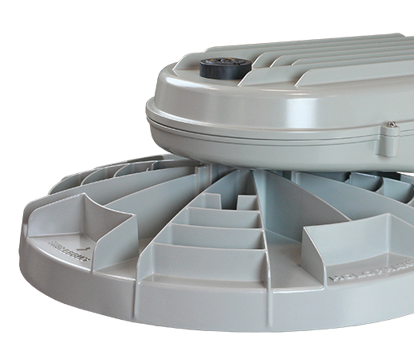
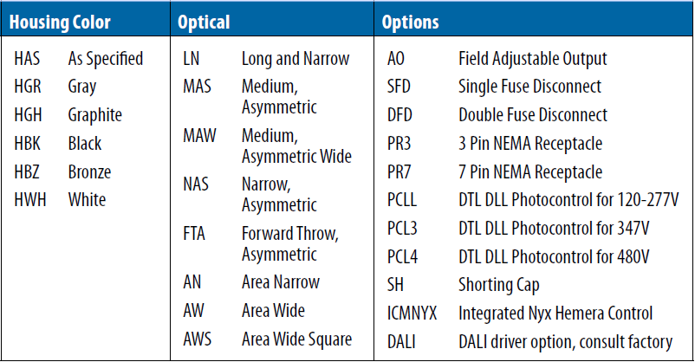
HMLED4 Nomenclature
New options added to HMLED4
Note that some nomenclature has changed from HMLED3 to HMLED4

Slide 14
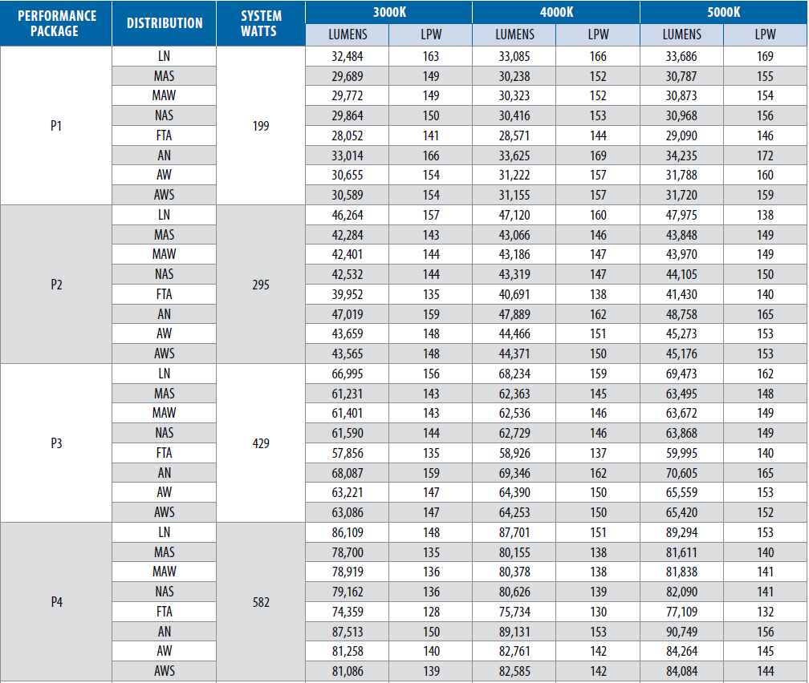
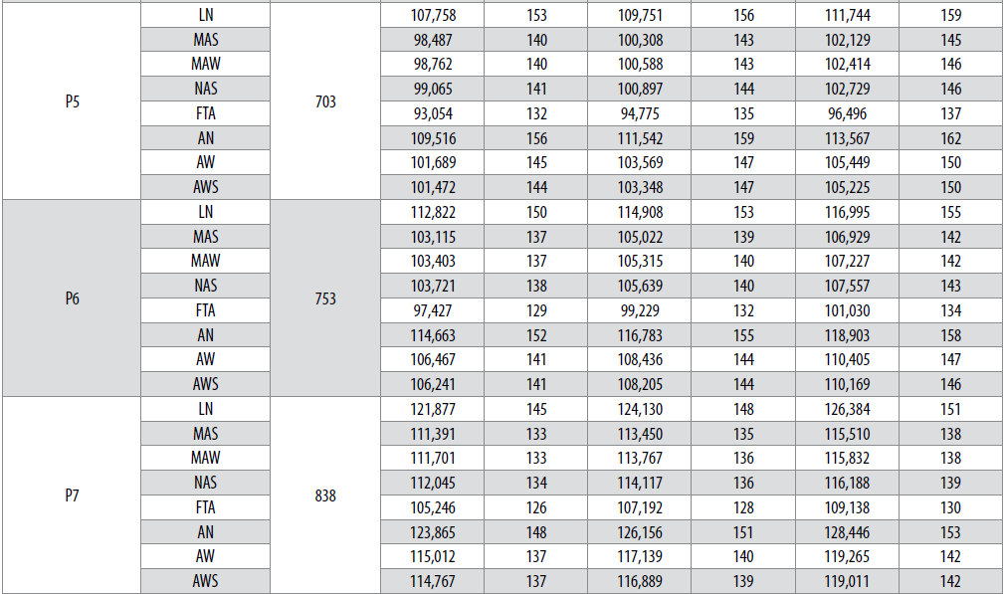
HMLED4 Performance Packages
P5-P7 expand the lumen options beyond
anything that HMLED3 offered!
HMLED4 P1-P4 are similar (but better!) to HMLED3 PK1-PK4

Slide 15
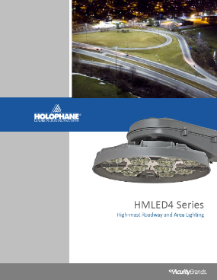
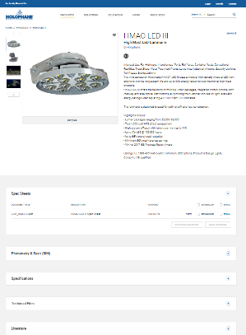
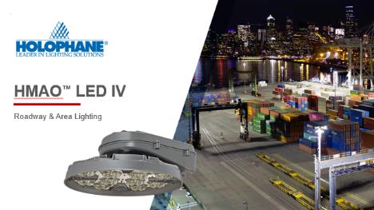
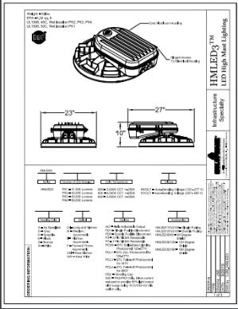
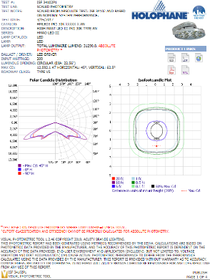
Launch Schedule – start building your project pipeline!
MARKETING LAUNCH:
  New Brochure
  New PPT Presentation
  Updated web page
  New Spec Sheets
  New Photometry
  Envision Updated
HMLED3 phase out plan:
  Available 3-6 months after launch, until remaining inventory is consumed
  Start migrating your customers and specifications
HMLED4
Due to impact of COVID-19 epidemic, we will start with extended manufacturing lead times (40 days+), but reduce those to a normative 15 day lead time ASAP

